Slide 1
C.E.L.E.U.S
Ceres Experimental Long Engagement Unit System
Project Manager: Sean MacBride
Project Scientist: Jamel Miller
Mission Architect: Kathryn Goodale
Lead Engineer: Amanda McNeil

Slide 2
Why Ceres and Why now?
Send a rover to determine
Geologic Structure of Ceres
Help us better understand Earth
Organic composition of Ceres
Help us better determine habitable environments in solar system
Surface composition of Ceres
Help us better understand habitable environment in solar system
Operations could potentially run for 17 years after landing on Ceres
Notes:
SEAN

Slide 3
In regards to the Decadal Survey
What were the initial stages, conditions, and processes of solar system formation and the nature of interstellar matter that was incorporated?
3. What governed the accretion, supply of water, chemistry, and internal differentiation of the inner planets and the evolution of their atmosphere, and what roles did bombardment by large projectiles play?
4. What were the primordial sources of organic matter, and where does organic synthesis continue today?
6. Beyond Earth, are there modern habitats elsewhere in the solar system with necessary conditions, organic matter, water, energy, and nutrients to sustain life, and do organism live there now?
10. How have the myriad chemical and physical processes that shaped the solar system operated, interacted, and evolved over time?
Notes:
SEAN

Slide 4
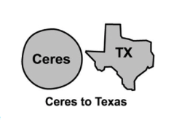
Scientific Background:
Ceres’ player card:
Day length: ~9 hours ( 1 year=4.6 earth years)
Radius: 476 km
Mass: 8.958x10^20 kg
Gravity: 0.27 m/s^2
Distance from earth: 1.496x10^8 km
Dawn is the first spacecraft to orbit a dwarf planet Ceres.
Notes:
JAMEL

Slide 5
Instrumentation & Datasets:
Level 1 mission goals:
Determine the composition of Ceres’ surface.
Lander with a variety of scientific instruments.
Use instruments to learn more about the geologic structure of Ceres
Using GPR and Seismometer to accomplish this
Look for potential organic compounds
Analyze surface and subsurface samples using a drill, robotic arm and the organic molecule detectors aboard the lander.
Notes:
AMANDA

Slide 6
Traceability Matrix
Level 1 Goals | Measurement | Instrument | Sampling
Determine the composition of Ceres surface, and the abundance of materials. | 1. The abundance of different elements. | 1. GC/MS 2. Organic molecule detector | 1. Sampling for GC/MS from drill sampler 2. Drill core sampler
Use instruments to learn more about the geologic structure of Ceres. | 1. analyze the waves produced by a know source. 2. analyze waves bouncing off of the interior layers of the dwarf planet | 1. Seismometer 2. Ground-Penetrating- Radar 3. Heat flow probe | Seismometer will be used to detect tectonic activity GPR used to scan subsurface of Ceres Heat flow probe to determine if head is flowing from inside Ceres
Look for potential organic compounds. | 1. The identification of organics. | 1. Organic molecule detector. | 1. organics analyzed on the ground by the lander made with Drill core sampler.
Notes:
JAMEL

Slide 7
Concept of Operations
Science Mode - analyzing samples
Drilling Mode - drilling and collect samples
Observation Mode - scanning the surroundings
Hibernation Mode - resting the tech for later use
1.295yrs from earth orbit to ceres
Have up to 17 years of potential exploration
Launch spacecraft
2 yrs orbiting earth
Astro maneuvers to land the rover
Notes:
KATIE

Slide 8
Flight Plan:
C
S
E
Notes:
KATIE

Slide 9
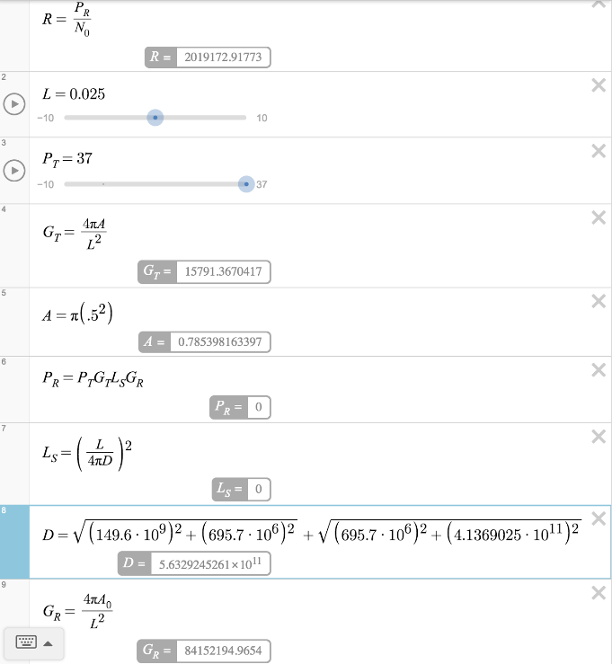
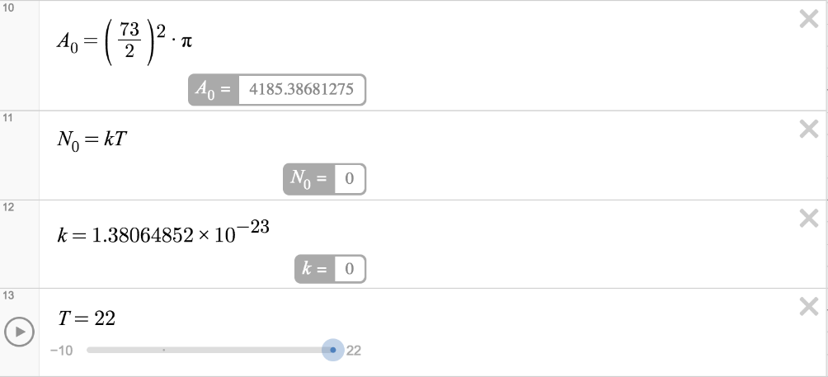
Calculations for Antenna
Notes:
SEAN

Slide 10
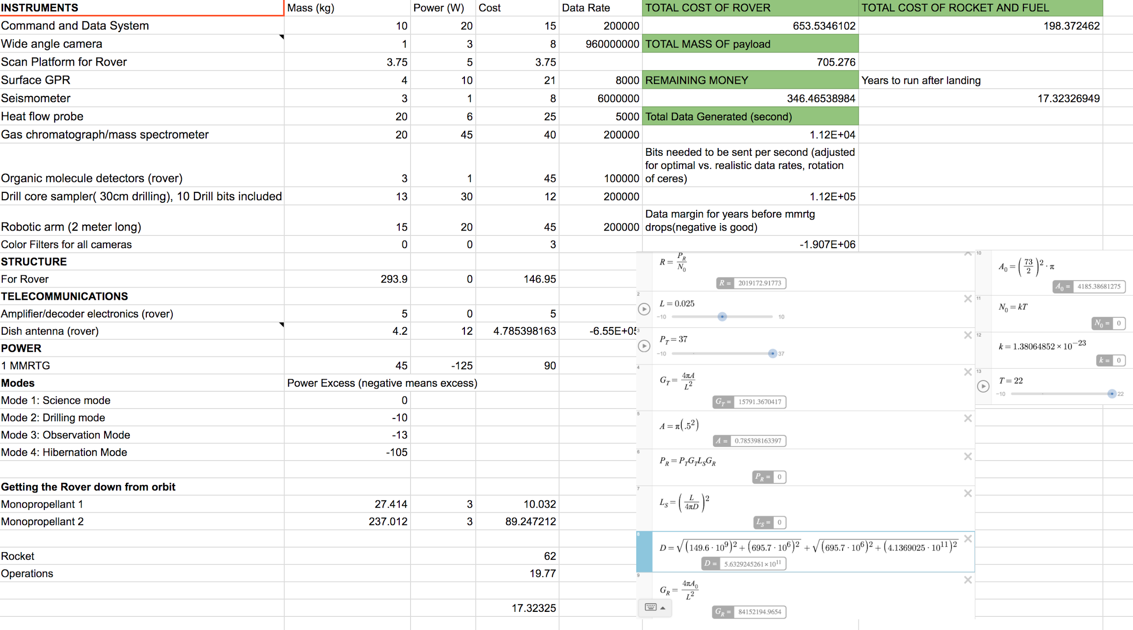
Notes:
SEAN

Slide 11
Risk Assessment
Ceres Capture
Entry to Ceres
Drill Failure
Notes:
SEAN

